Slide 1

XSS (Web Security)
Dr. Muhammad Umar Aftab

Slide 2

Outline
Introduction
How XSS Attack Works
Attack 1: Add Friend
Attack 2: Modify
Writing Self-Propagating XSS Worm
Countermeasures
CSP: Content Security Policy
Attack Generalization

Slide 3
Introduction
Introduction about Cross-Site Scripting Attack (XSS)

Slide 4
Introduction
In 2005, samy kamkar generate a worm on a social media website (myspace.com) that carry a payload. As victims clicked on payload, two things happened; I) samy was added as friend on victim profile II) The profiles of victims were updated with text that “Samy is my hero”.
This worm victimized one million users within 20 hours on October 4, 2005.

Slide 5
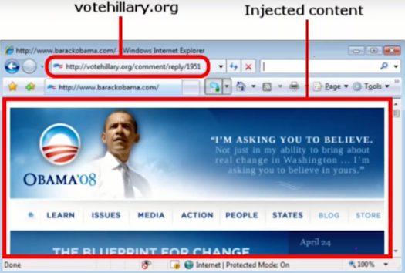
Introduction
In 2008, there was election in US Obama and Hillary were candidates. Hillary had a website for election campaign with url “votehillary.org”. This website become victim of XSS attack.
This attack change the content of website “votehillary.org”. The url was same, but content was Obama’s website

Slide 6
How XSS Attack Works
The explanation of cross-site scripting working

Slide 7
What is Cross-Site Scripting (XSS)
The XSS attack is a form of malicious code injection in victim’s system through website or web server.
The victim send single-site request to legal and authenticated server. But attacker inject the code in response of server due to server vulnerability.
As browser see code in http response, the browser immediately execute the code.

Slide 8

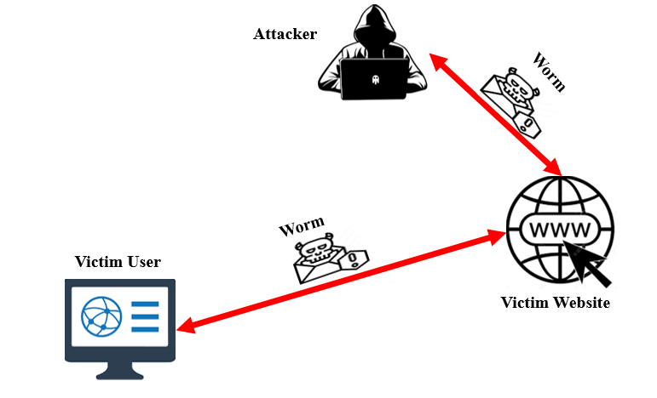
Difference b/w CSRF and XSS
CSRF Attack
XSS Attack

Slide 9
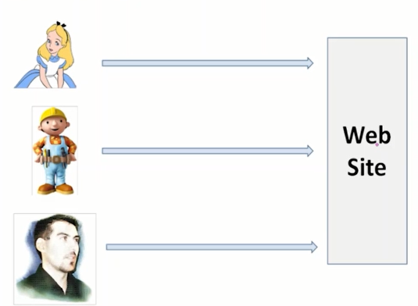
Session and XSS Attack

Slide 10
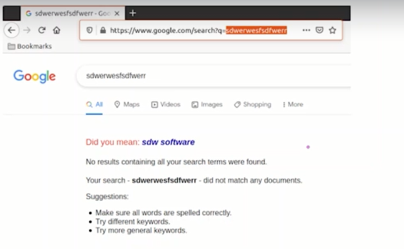
Types of XSS attack
There are two types of XSS attack:
Non persistent XSS Attack
Persistent XSS Attack (i.e., Samy worm example)
Notes:
Persistent: The malicious script is permanently stored on the target server (e.g., in a database, message board, comment section).
Non-Persistent: The malicious script is not stored on the server; instead, it comes from the user’s request and is reflected back immediately in the response.

Slide 11
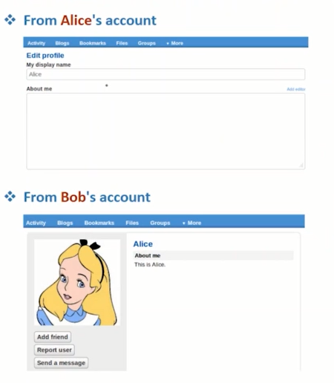
Persistent Attack Example

Slide 12
Damages
Attack server
The attacker will send http request to server on behalf of user. The server will respond and update user profile according to attacker’s http request.
Web Defacing
JavaScript code run inside page and code has privilege to access element of page. The code can change, modify and delete the element.
Obama and Hillary XSS case was web defacing on client side.

Slide 13
Attack 1: Add Friend
XSS Persistent Attack
The Objective of this attack is to add attacker in victim’s friend list as victim visit attacker profile
Notes:
Cross-site scripting (or XSS) allows an attacker to execute arbitrary JavaScript within the browser of a victim user. Cross-site request forgery (or CSRF) allows an attacker to induce a victim user to perform actions that they do not intend to.

Slide 14
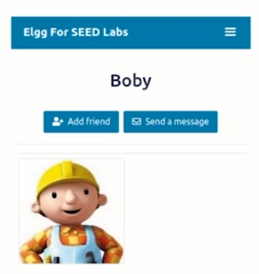
Add Friend Http Request

Slide 15
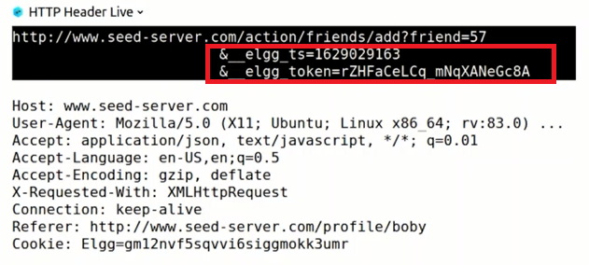
Investigation
The attacker will investigate the GET method request before launch the attack.

Slide 16
How attacker can get tokens and Timestamp
CSRF Attack
XSS Attack

Slide 17
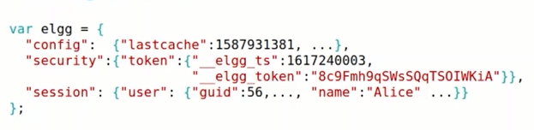
How attacker can get tokens and Timestamp
The developer use global variable for token and timestamp inside webpage.
When attacker’s malicious code is inside the webpage, then code can easily access the global variable of token and timestamp
Elgg.security.token.__elgg_token

Slide 18
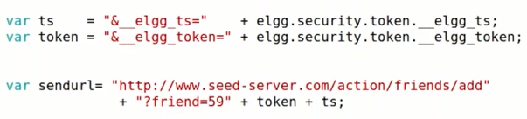
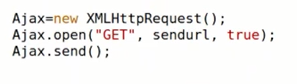
Construct the URL for Attack and ajax code
Construct the URL
Ajax Code

Slide 19
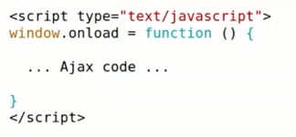
Complete the Code
Complete the code and place it in plaintext mode in attacker profile.

Slide 20
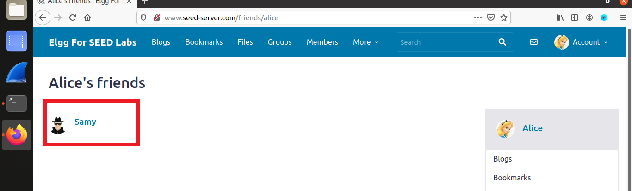
Reaction of the attack
As victim will visit the Samy's profile. The code will trigger and samy will be added in friend list of victim.

Slide 21
Attack 2: Modify
The Objective of this attack is to edit victim’s profile as victim visit attacker profile

Slide 22
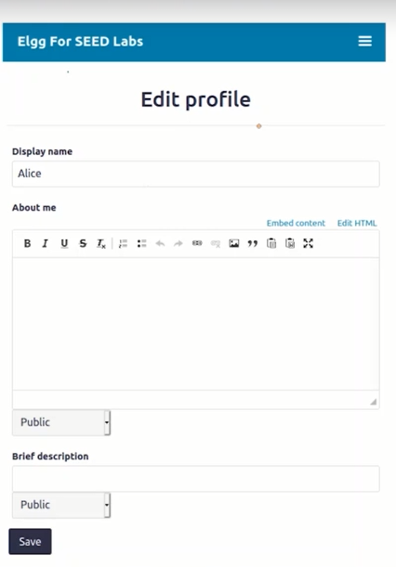
Edit Profile Http Request

Slide 23
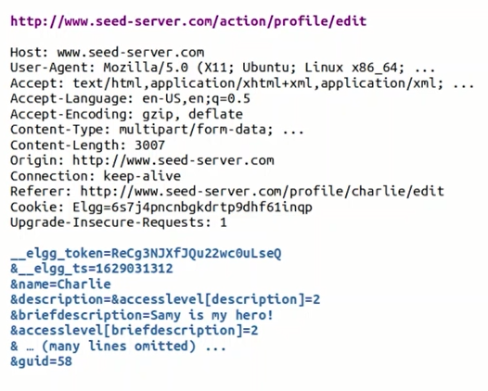
Investigate the request

Slide 24
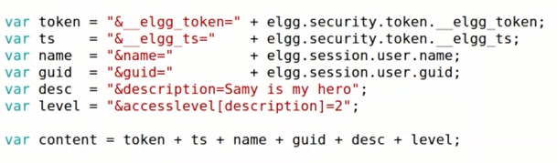
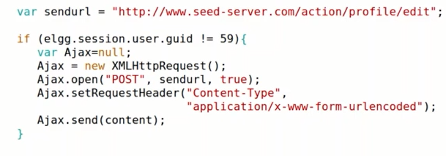
Construct the data and ajax code

Slide 25
Complete the Code
Complete the code and place it in plaintext mode in attacker profile.

Slide 26
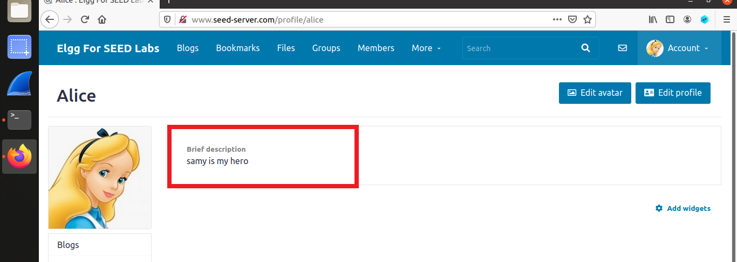
Reaction of Attack

Slide 27
Writing Self-Propagating XSS Worm

Slide 28
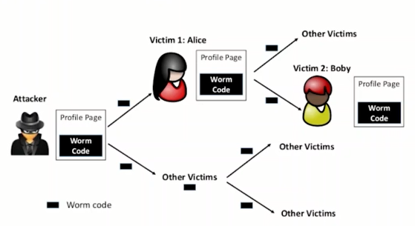
Spreading Worm Exponentially

Slide 29
How to make identical copy of malicious code
There are two ways to make identical copy of malicious code
By yourself (Self-Reproducing)
Using external help

Slide 30
By Yourself (Self-Reproducing)
By yourself approach means that put copy of your code inside your code.
Mechanism: Its means that attacker have to write code that will print its own source code without reading any external file.
This technique also called “Quine”.

Slide 31
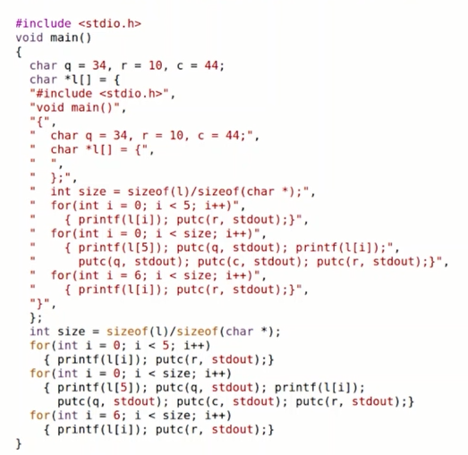
Pure Self-Reproducing Code: Quine

Slide 32
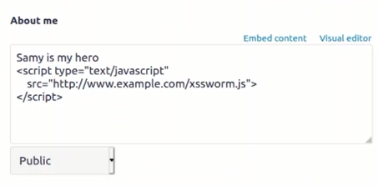
Using External Help
Using external help means that save your code at somewhere else and load it when needed.

Slide 33
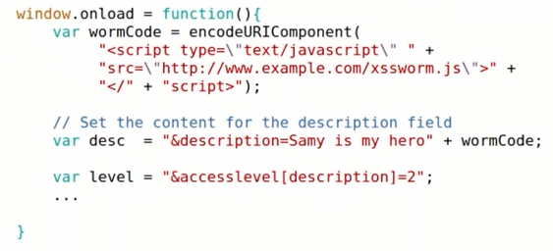
Worm Code xssworn.js

Slide 34
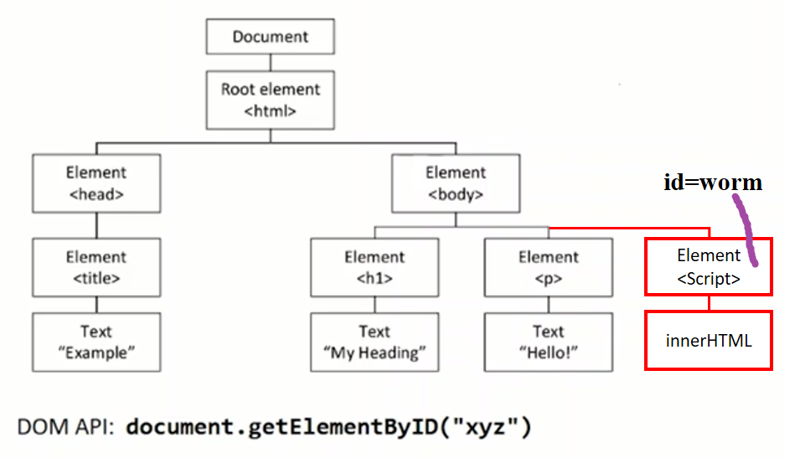
Using External Help (Another Way)
Another way is that load code inside element of page as content. As web page load in browser, the browser has API to access element by id.

Slide 35
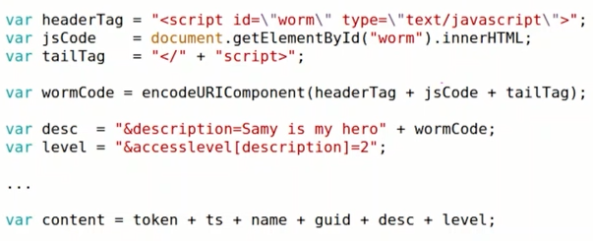
Construct the Code

Slide 36
Countermeasures
Prevention from XSS attack

Slide 37
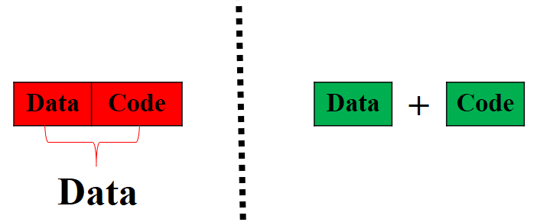
Fundamental problem of XSS
Mixing data and code is hard to separate because both have same format like string. So this is fundamental problem, because server can not sense that data coming from user has malicious code inside it or not.

Slide 38
1st Solution: Apply Filter on Data Extract Code
Different filters can be applied on data coming from users to separate data and code.
Samy’s strategy:
<div style=“background:url(‘javascript:alert(1)’)”>
Filter 1: Myspace filter block tags i.e., “<script>” , “<head>”, “<body>” etc
Samy’s Strategy:
<div style=“background:url(‘javascript(1)’)”>
Filter 2: Myspace strips out word javascript from anywhere.
Samy’s Strategy:
eval(‘xmlhttp.onread’ + ‘ystatechange = callback’);
Filter 3: Myspace strips out the word “onreadystatechange”.
The filter are not effective, because hackers have creative nature. So they can counter the filters.

Slide 39
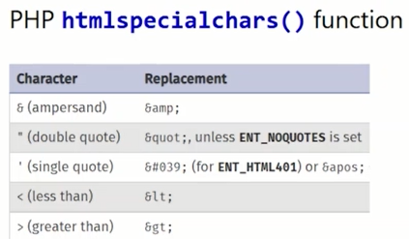
2nd Solution: Turning Code into Data
2nd solution is that turn code into data with help of special characters. So full dictionary of special characters is required to convert code into data.
But problem is that this solution also can be bypass easily.

Slide 40
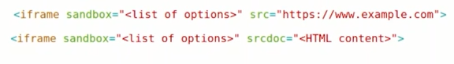
3rd Solution: Treating data only as data
3rd solution is that use iframe as functionality of sandboxing. Actually, this solution says to browser that treat data=[data+code] as data even it have code.
Setting Sandbox
Options of Privilege Level
allow-scripts
allow-same-origin
allow-forms
allow-modals
allow-top-navigation

Slide 41
CSP: Content Security Policy
Basically CSP is another countermeasure of XSS.
Notes:
Content Security Policy (CSP) is an added layer of security that helps to detect and mitigate certain types of attacks, including Cross-Site Scripting (XSS) and data injection attacks. These attacks are used for everything from data theft, to site defacement, to malware distribution.

Slide 42
The confused deputy/origin problem
The CSP helps the browser to know about deputy/origin of code and data. The CSP force the code to be labelled with respect to deputy/origin/source.

Slide 43
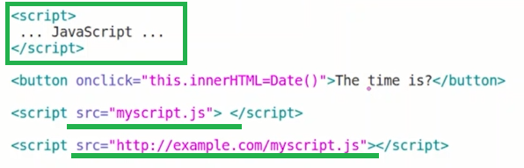
Forcing Code to be Labelled
There are two ways to include javascript code inside HTML; I) Inline approach II) Linked Approach.
The source of linked approach must be labelled, because code may be coming from some other resources.
One source is labelled, Then CSP privilege to code.

Slide 44
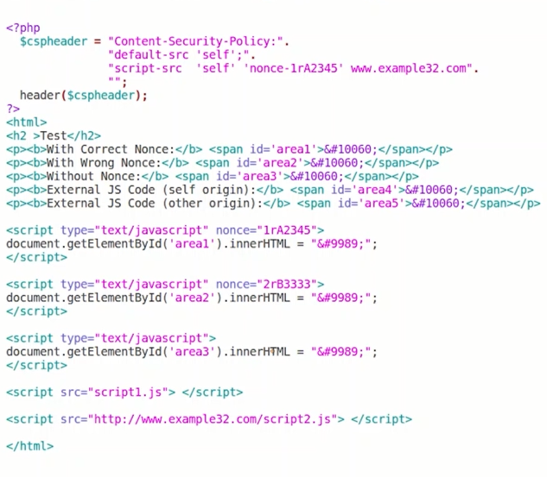
CSP Example: PHP Code

Slide 45
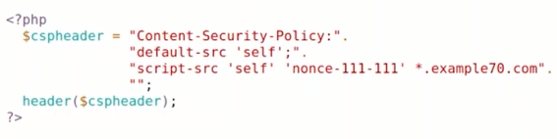
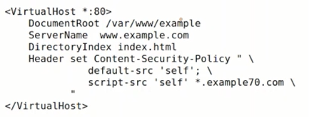
Setting Content Security Policy
Setting CSP in PHP Code: (Used for multiple headers)
Setting CSP on Apache: (used for single types of header)

Slide 46
Attack Generalization

Slide 47
Attack on HTML5 based Mobile Application
The mobile phones have different operating systems and architecture like android and iOS. The application developer have to write separate code for both android and iOS applications.
So developers convert android and iOS applications into web based applications that support to both platform.
The vulnerability like CSRF and XSS comes into mobile applications due to web browser based applications

Slide 48
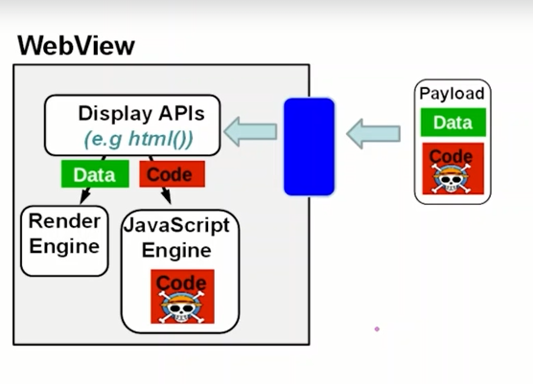
Code Injection into Mobile

Slide 49
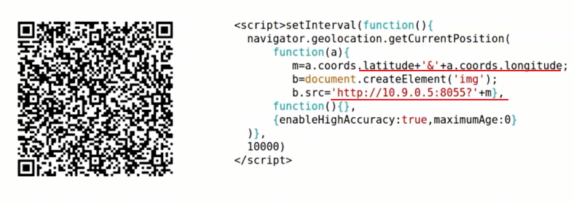
Attack via QR Code

Slide 50
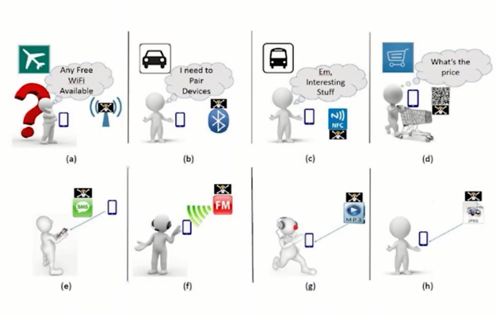
Attack Stuff

Slide 51
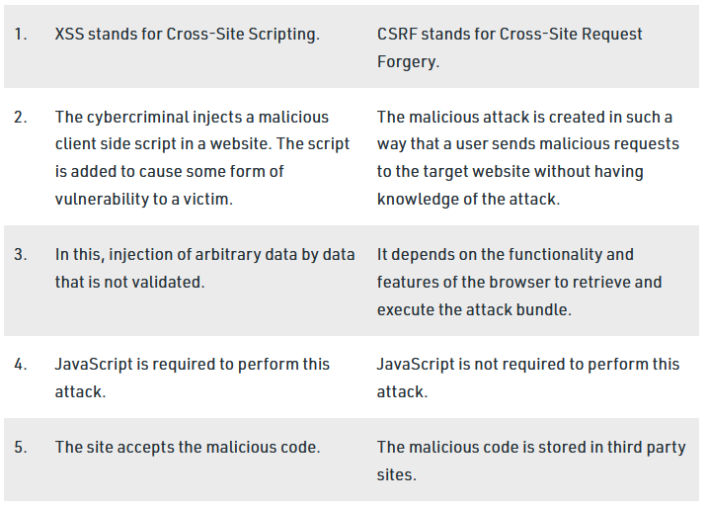
XSS vs CSRF

Slide 52
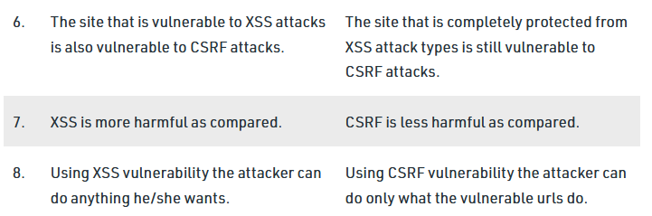
XSS vs CSRF

Slide 53


